Slide 1
REQUIREMENTS SPECIFICATION AND ANALYSIS
Notes:
During the first phase of object oriented system development the following major activities are performed. System Requirement Specifications (SRS), Use case modeling and documentation (for each use case identified), and the development of sequence diagrams, class diagram and supplementary specifications.

Slide 2

Requirement gathering is a way of collecting information to improve or change the existing System by the new system. In this project, the team used an object oriented system development methodology which incorporates two principal phases. These principal phases are Object-Oriented Analysis and Object-oriented Design. This chapter discusses the first phase of the methodology: object oriented analysis (OOA).
Notes:
During the first phase of object oriented system development the following major activities are performed. System Requirement Specifications (SRS), Use case modeling and documentation (for each use case identified), and the development of sequence diagrams, class diagram and supplementary specifications.
Purpose
The purpose of this section of the document is to provide an overview of the proposed system, how to build the proposed system, to have clear view or model of the system, an input for design phase and to obtain the information needed to develop the actual implementation of our system.

Slide 3
Objective
Individuals can order products from SME.
SME can
participate in Bid
advertise their products
accept orders from consumers(user)
User can
search for SME by their names.
search for SME by using SME’s ID
Generate a monthly and annual reports
Notes:
The objective of this phase is to develop the requirement specification and analysis as it started from last section by using the information planned. The requirement specification is the phase that leads to the designing and implementation.
The correct and accurate designing has a great role to the system implementation. Based on this designing our target is for providing the web based system to the Hawassa city Small and micro enterprises

Slide 4
Functional Requirements
Signup/Create account
Login
Logout
order products
Participate in a Bid
Advertise their products
Searching for SME :
Generate monthly report
Notes:
Functional requirements
are the description of the facility or feature required.
deal with what the system should do or provide for users. They include description of the required functions, outlines of associated reports or online queries, and details of data to be held in the system.
The functional requirement of our system include the following
using this two distinct accounts is for the fact that the system restrict and give access privilege depending upon who is logged in. SME and individual user have different accessing privilege whenever they interact.
In the process of logging as SME or IU (individual user), it’s must to have valid user name and password. Then they can access the system but if the Username or Password is not correct access will be denied.
Any user is recommended to properly logout after finishing his/her activities in the system. This task is needed for both individual users as well as the SME.
Another functionality provided by the system is ordering products from SME. This functionality is possible for both UI and SMI (among themselves) accounts, SME can order another SME a product which could be an input product for itself.
Our system provide a way of promoting the products of Small and micro enterprises. There will be a place dedicated/reserved for advertisement in our webpage. So that SME can advertise their products and attract their customers.
User can search for small and micro enterprise just only by providing the name of the SME.so that he/she can interact with the enterprise
Generate monthly report about all the things going on by the system.

Slide 5
Product Functions
The new proposed system will perform different tasks, such as:
SME can see their organized profile.
SME can register or create account.
IU can register or create account.
User can search for SME by using name of the SME
IU and SME can see the corporate schedule of SME Timetable (calendar).
Admin can manage and administer the Bid process
Admin edit remove SME or IU accounts
Notes:
Product Perspective
The proposed Web based application for Hawassa city small and micro enterprises office which will be developed by the project team member in website crew.

Slide 6
Principal Actors
An actor represents any person that interacts with the system. The principal actors in this system are:
Administrator
SME(small and micro enterprises)
IU (individual users)
Notes:
ADMIN is the responsible person in the organization, an authorized person who look after and control the whole system also called system administrator.
SME are registered members in the system and identified and gave access privilege which is given as a Small and micro enterprises.
an individuals who interact with the system as an individual rather than as SME. They are mostly considered as a consumers or a product/service seekers from the enterprises.

Slide 7
User Characteristics
It allows the team to clearly define and focus on who the end users are for the project and also it allows the team to check the progress of project.
Educational level: Users should be familiar with English language.
Skills: IU and SME should have a little knowledge about the system.
Notes:
User characteristics are an important aspect for any project.
Educational level: Users should be familiar with English language.
Skills: IU and SME should have a little knowledge about the system and the administrator should have enough knowledge on how to operate/control the system.

Slide 8
General Constraints
Administer or the body of government take over all control for this application in case of security.
The user must have a personal computer.
The user is expected to have internet access .
Registered member can use this application by using correct user ID and password.
IU cannot delete any records from the database.
The administrator has the privilege to manipulate bid process
It’s illegal to have more than one account, it considered as a fraud account.
Notes:
When developing this system, we as a developer justify the following constraints for the accurate use of the developed system
Administer or the body of government especially the department of cooperating SMEs take over all control for this application in case of security.
The user must have a personal computer or mobile to access the system
The user is also expected to have internet access since it will be hosted On the internet.
Registered member (IU or SME) can use this application by using correct user ID and password.
IU cannot delete any records from the database.
The administrator is the one who has the privilege to manipulate bid process
It’s illegal to have account more than one, it considered as a fraud account

Slide 9
Assumptions and Dependencies
The system assumes that the administrator has enough knowledge about server administration
It is assumed the maintenance of the database will be assigned to the authorized person only.
Individual users or guests have a restricted privilege.
Any user can’t access confidential information of other SME/users in the system.
Notes:
(especially Window Server 2008 and WAMP Server).

Slide 10
Non-functional Requirements
Security and Access permissions
User Interface
No Redundancy
Availability
Error handling
System modification:
Notes:
Non-functional requirements are requirements that are not directly concerned with the specific services delivered by the system to its users. They may relate to emergent system properties such as reliability, response time, and store occupancy. Alternatively, they may define constraints on the system implementation such as the capabilities of I/O devices or the data representations used in interfaces with other systems.
Non-functional requirements, such as performance, security, or availability, usually specify or constrain characteristics of the system as a whole.
We are going to develop two privilege for User and administrator. Depending upon the category of user access rights are decided
The developed system provides an HTML webpage which is expected from the users to interact with the system
: In the proposed system can be avoided reputation of data anywhere in the database but there may be reputation in case of data backup. This would assure economic use of storage space and consistency of the data stored in the database
All data in the system will be available at any time
When the users of the system interact with the system errors may appear. To control these inaccuracies the system will generate different messages
: Through time there are always changes when the user’s needs another additional functionality, when the system administrator identifies the system need to be modified, while the organizations work style is changed and depending on different reasons.

Slide 11
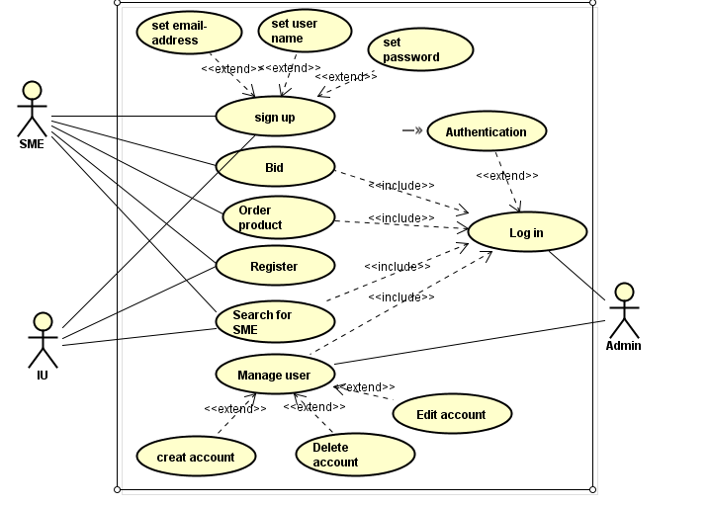
Use case Diagram
Notes:
Use case identifies processes or activities that can be done within the system. It also describes a sequence of actions that provide a measurable value to an actor.
System Models
3.11.1 Essential Use case Diagram
Use case identifies processes or activities that can be done within the system. A use case is also a set of scenarios tied together by a common user goal. A scenario is a sequence of steps describing an interaction between a user and a system. A system use case model is composed of a use case diagram and the accompanying documentation, the use cases , actors and associations. It also describes a sequence of actions that provide a measurable value to an actor. The following use case diagram describes the overall functionality of web platform for Hawassa City Small and Micro enterprises.

Slide 12
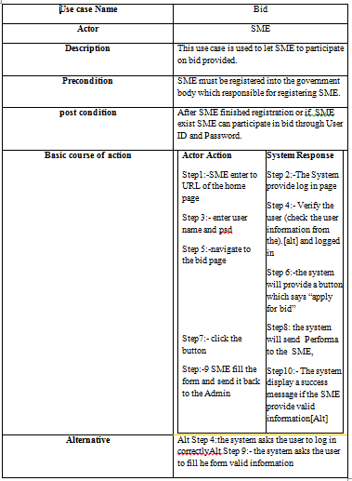
Notes:
Use case Descriptions
The tables show the use case documentation for the use cases that are illustrated in the above use case diagram. Each table contains the use case name, the actor which initiates and interacts with the use case, description of the use case and typical course of events that show the interaction between the actor and the use case which enable the team to easily depict the functions of the proposed system

Slide 13
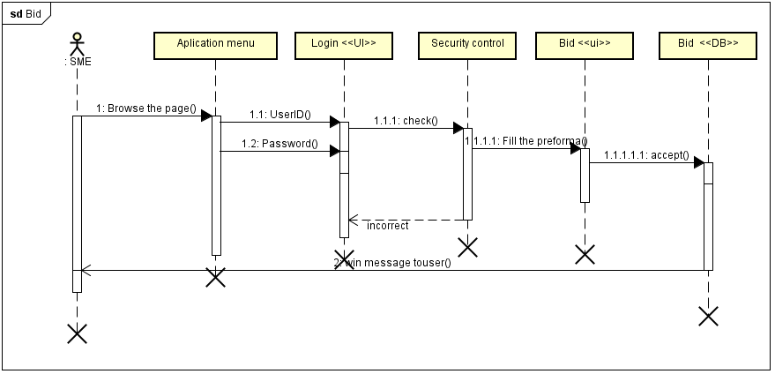
Sequence Diagram - Bid
Notes:
A sequence diagram is an interaction diagram which is an easy and innate way of describing the behavior of a system by viewing the interaction between the system and its environments. It is very simple and has immediate visual appeal-this is a great strength. Generally it is an alternative way to understand the overall flow of the control of a program.

Slide 14
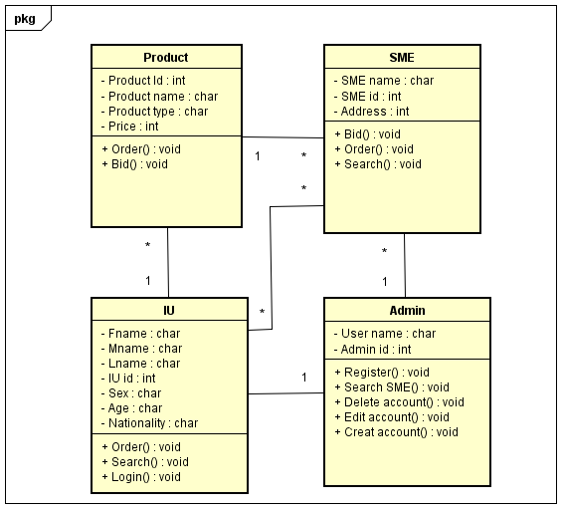
Class Diagram
Notes:
Class Diagram
is a component of unified modelling language that shows level of association among classes and objects.
It also shows multiplicity associations, that means how many objects participate on the association.
shows the role of objects or classes and aggregations.
Also describe the structure of the system in terms of classes and objects. Classes are abstractions that specify the attributes and behaviors of a set of objects. Objects are entities that encapsulate state and behavior each object has an identity.

Slide 15
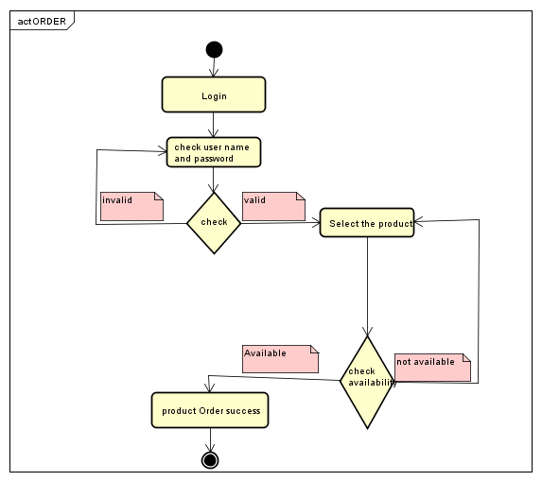
Activity diagram
Notes:
Activity diagram
describes a system in terms of activities. Activities are states that represent the execution of a set of operations. The completion of these operations triggers a transition to another activity.
Is also similar to flowchart diagrams in that they can be used to represent control flow (i.e., the order in which operations occur) and data flow (i.e., the objects that are exchanged among operations).

